Slide 1
CMU 10-742 Machine Learning in Healthcare
Lecture 15: Text Processing in Healthcare
Adam Berger

Slide 2
Course Logistics
Assignment 4 due today
Final Project Milestone 2 is Nov 7

Slide 3
Outline
Clinical Notes
Modeling text
Clinical NLP
Secondary use
ClinicalBERT

Slide 4
Typical note
Date: November 26, 2024 Patient: John Doe Age: 65 Sex: Male MRN: 123456789
Chief Complaint: Shortness of breath and chest pain.
History of Present Illness: The patient is a 65-year-old male with a known history of hypertension and Type 2 diabetes mellitus who presents with acute onset of shortness of breath and chest pain radiating to the left arm, starting approximately 2 hours prior to arrival. He describes the pain as sharp, 7/10 in intensity, and exacerbated by physical activity. He denies nausea, vomiting, or sweating.
Medications:
Lisinopril 10 mg daily
Metformin 500 mg twice daily
Allergies:
Penicillin (rash)
Physical Examination:
Vital Signs: BP 150/90 mmHg, HR 95 bpm, RR 20/min, SpO2 96% on room air
Cardiovascular: Regular rhythm, no murmurs.
Respiratory: Clear to auscultation bilaterally, no wheezing or crackles.
Assessment:
Suspected acute coronary syndrome
History of hypertension
History of Type 2 diabetes mellitus
Plan:
Order EKG and troponin levels.
Administer aspirin 325 mg now.
Stat cardiology consult for possible myocardial infarction.
Initiate continuous cardiac monitoring.
Patient education: Discussed the importance of medication adherence and lifestyle modifications.
Notes:
Patient shows up in the ER
Templated form with free text entries
(fictional note)

Slide 5
Typical note
Date: November 26, 2024 Patient: John Doe Age: 65 Sex: Male MRN: 123456789
Chief Complaint: Shortness of breath and chest pain.
History of Present Illness: The patient is a 65-year-old male with a known history of hypertension and Type 2 diabetes mellitus who presents with acute onset of shortness of breath and chest pain radiating to the left arm, starting approximately 2 hours prior to arrival. He describes the pain as sharp, 7/10 in intensity, and exacerbated by physical activity. He denies nausea, vomiting, or sweating.
Medications:
Lisinopril 10 mg daily
Metformin 500 mg twice daily
Allergies:
Penicillin (rash)
Physical Examination:
Vital Signs: BP 150/90 mmHg, HR 95 bpm, RR 20/min, SpO2 96% on room air
Cardiovascular: Regular rhythm, no murmurs.
Respiratory: Clear to auscultation bilaterally, no wheezing or crackles.
Assessment:
Suspected acute coronary syndrome
History of hypertension
History of Type 2 diabetes mellitus
Plan:
Order EKG and troponin levels.
Administer aspirin 325 mg now.
Stat cardiology consult for possible myocardial infarction.
Initiate continuous cardiac monitoring.
Patient education: Discussed the importance of medication adherence and lifestyle modifications.
SUBJECTIVE
Notes:
“SOAP”

Slide 6
Typical note
OBJECTIVE
Date: November 26, 2024 Patient: John Doe Age: 65 Sex: Male MRN: 123456789
Chief Complaint: Shortness of breath and chest pain.
History of Present Illness: The patient is a 65-year-old male with a known history of hypertension and Type 2 diabetes mellitus who presents with acute onset of shortness of breath and chest pain radiating to the left arm, starting approximately 2 hours prior to arrival. He describes the pain as sharp, 7/10 in intensity, and exacerbated by physical activity. He denies nausea, vomiting, or sweating.
Medications:
Lisinopril 10 mg daily
Metformin 500 mg twice daily
Allergies:
Penicillin (rash)
Physical Examination:
Vital Signs: BP 150/90 mmHg, HR 95 bpm, RR 20/min, SpO2 96% on room air
Cardiovascular: Regular rhythm, no murmurs.
Respiratory: Clear to auscultation bilaterally, no wheezing or crackles.
Assessment:
Suspected acute coronary syndrome
History of hypertension
History of Type 2 diabetes mellitus
Plan:
Order EKG and troponin levels.
Administer aspirin 325 mg now.
Stat cardiology consult for possible myocardial infarction.
Initiate continuous cardiac monitoring.
Patient education: Discussed the importance of medication adherence and lifestyle modifications.

Slide 7
Typical note
Date: November 26, 2024 Patient: John Doe Age: 65 Sex: Male MRN: 123456789
Chief Complaint: Shortness of breath and chest pain.
History of Present Illness: The patient is a 65-year-old male with a known history of hypertension and Type 2 diabetes mellitus who presents with acute onset of shortness of breath and chest pain radiating to the left arm, starting approximately 2 hours prior to arrival. He describes the pain as sharp, 7/10 in intensity, and exacerbated by physical activity. He denies nausea, vomiting, or sweating.
Medications:
Lisinopril 10 mg daily
Metformin 500 mg twice daily
Allergies:
Penicillin (rash)
Physical Examination:
Vital Signs: BP 150/90 mmHg, HR 95 bpm, RR 20/min, SpO2 96% on room air
Cardiovascular: Regular rhythm, no murmurs.
Respiratory: Clear to auscultation bilaterally, no wheezing or crackles.
Assessment:
Suspected acute coronary syndrome
History of hypertension
History of Type 2 diabetes mellitus
Plan:
Order EKG and troponin levels.
Administer aspirin 325 mg now.
Stat cardiology consult for possible myocardial infarction.
Initiate continuous cardiac monitoring.
Patient education: Discussed the importance of medication adherence and lifestyle modifications.
ASSESSMENT

Slide 8
Typical note
Date: November 26, 2024 Patient: John Doe Age: 65 Sex: Male MRN: 123456789
Chief Complaint: Shortness of breath and chest pain.
History of Present Illness: The patient is a 65-year-old male with a known history of hypertension and Type 2 diabetes mellitus who presents with acute onset of shortness of breath and chest pain radiating to the left arm, starting approximately 2 hours prior to arrival. He describes the pain as sharp, 7/10 in intensity, and exacerbated by physical activity. He denies nausea, vomiting, or sweating.
Medications:
Lisinopril 10 mg daily
Metformin 500 mg twice daily
Allergies:
Penicillin (rash)
Physical Examination:
Vital Signs: BP 150/90 mmHg, HR 95 bpm, RR 20/min, SpO2 96% on room air
Cardiovascular: Regular rhythm, no murmurs.
Respiratory: Clear to auscultation bilaterally, no wheezing or crackles.
Assessment:
Suspected acute coronary syndrome
History of hypertension
History of Type 2 diabetes mellitus
Plan:
Order EKG and troponin levels.
Administer aspirin 325 mg now.
Stat cardiology consult for possible myocardial infarction.
Initiate continuous cardiac monitoring.
Patient education: Discussed the importance of medication adherence and lifestyle modifications.
PLAN

Slide 9
Typical note
Date: November 26, 2024 Patient: John Doe Age: 65 Sex: Male MRN: 123456789
Chief Complaint: Shortness of breath and chest pain.
History of Present Illness: The patient is a 65-year-old male with a known history of hypertension and Type 2 diabetes mellitus who presents with acute onset of shortness of breath and chest pain radiating to the left arm, starting approximately 2 hours prior to arrival. He describes the pain as sharp, 7/10 in intensity, and exacerbated by physical activity. He denies nausea, vomiting, or sweating.
Medications:
Lisinopril 10 mg daily
Metformin 500 mg twice daily
Allergies:
Penicillin (rash)
Physical Examination:
Vital Signs: BP 150/90 mmHg, HR 95 bpm, RR 20/min, SpO2 96% on room air
Cardiovascular: Regular rhythm, no murmurs.
Respiratory: Clear to auscultation bilaterally, no wheezing or crackles.
Assessment:
Suspected acute coronary syndrome
History of hypertension
History of Type 2 diabetes mellitus
Plan:
Order EKG and troponin levels.
Administer aspirin 325 mg now.
Stat cardiology consult for possible myocardial infarction.
Initiate continuous cardiac monitoring.
Patient education: Discussed the importance of medication adherence and lifestyle modifications.
Notes:
How much of this is available in the ‘coded’ part of the EHR ?

Slide 10
Date: November 26, 2024 Patient: John Doe Age: 65 Sex: Male MRN: 123456789
Chief Complaint: Shortness of breath and chest pain.
History of Present Illness: The patient is a 65-year-old male with a known history of hypertension (I10) and Type 2 diabetes mellitus (E11.9) who presents with acute onset of shortness of breath and chest pain radiating to the left arm, starting approximately 2 hours prior to arrival. He describes the pain as sharp, 7/10 in intensity, and exacerbated by physical activity. He denies nausea, vomiting, or sweating.
Medications:
Lisinopril 10 mg daily
Metformin 500 mg twice daily
Allergies:
Penicillin (rash)
Physical Examination:
Vital Signs: BP 150/90 mmHg, HR 95 bpm, RR 20/min, SpO2 96% on room air
Cardiovascular: Regular rhythm, no murmurs.
Respiratory: Clear to auscultation bilaterally, no wheezing or crackles.
Assessment:
Suspected acute coronary syndrome (I21.9)
History of hypertension (I10)
History of Type 2 diabetes mellitus (E11.9)
Plan:
Order EKG and troponin levels.
Administer aspirin 325 mg now.
Stat cardiology consult for possible myocardial infarction.
Initiate continuous cardiac monitoring.
Patient education: Discussed the importance of medication adherence and lifestyle modifications.
Notes:
Green – likely coded elsewhere (structured)
Notice most is not green! Not coded

Slide 11
Pathology Report
Patient Name: Jane Smith Date of Birth: 03/15/1975 Date of Procedure: 11/05/2024 Accession Number: 24-98765 Specimen Type: Breast biopsy (left)
Clinical History:
49-year-old female with a 1.5 cm palpable mass in the upper outer quadrant of the left breast. Mammography shows a suspicious mass (BI-RADS category 4), and a biopsy was performed for histopathological evaluation.
Gross Description:
Specimen received: One core biopsy, 1.2 cm in length.
The specimen is labeled with the patient’s name and site as “left breast mass.”
The core is firm and tan in color, with no grossly visible abnormalities.
Microscopic Description:
The biopsy specimen is processed and stained with hematoxylin and eosin (H&E).
The tissue demonstrates fibroglandular breast parenchyma.
Within the specimen, there is a well-circumscribed lesion composed of atypical ductal cells arranged in a cribriform and micropapillary pattern.
The cells show moderate nuclear pleomorphism and increased mitotic activity.
No evidence of necrosis is present.
Surrounding stroma is minimally reactive, with no significant desmoplastic response.
Lymphovascular invasion is not identified.
Immunohistochemistry (IHC):
Estrogen Receptor (ER): Positive (80% of cells)
Progesterone Receptor (PR): Positive (60% of cells)
HER2/neu: Negative (1+ by IHC)
Ki-67: 15% positive cells, indicating low proliferative index
Diagnosis:
Invasive ductal carcinoma, well-differentiated (Grade 1), measuring approximately 0.9 cm in greatest dimension, present within the submitted tissue.
ER-positive, PR-positive, HER2-negative.
No evidence of lymphovascular invasion.
Comment:
The findings are consistent with a low-grade invasive ductal carcinoma of the left breast. Given the hormone receptor positivity and HER2 negativity, this tumor is likely to respond to hormone therapy. Clinical correlation and further staging (e.g., sentinel lymph node biopsy) are recommended to assess the extent of disease.
Pathologist: Dr. Emily Turner, MD Date of Report: 11/06/2024
Notes:
Different kind of note
Sample pathology report. Completely different terminology.
Not even in SOAP format.
variety of clinical narratives

Slide 12
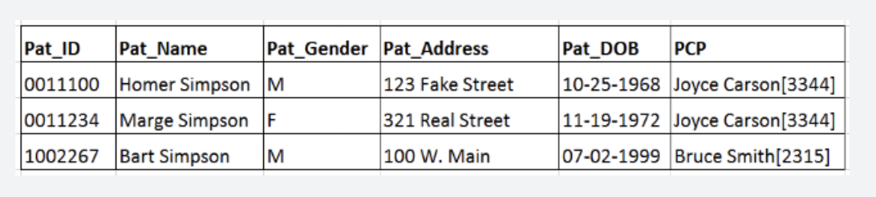
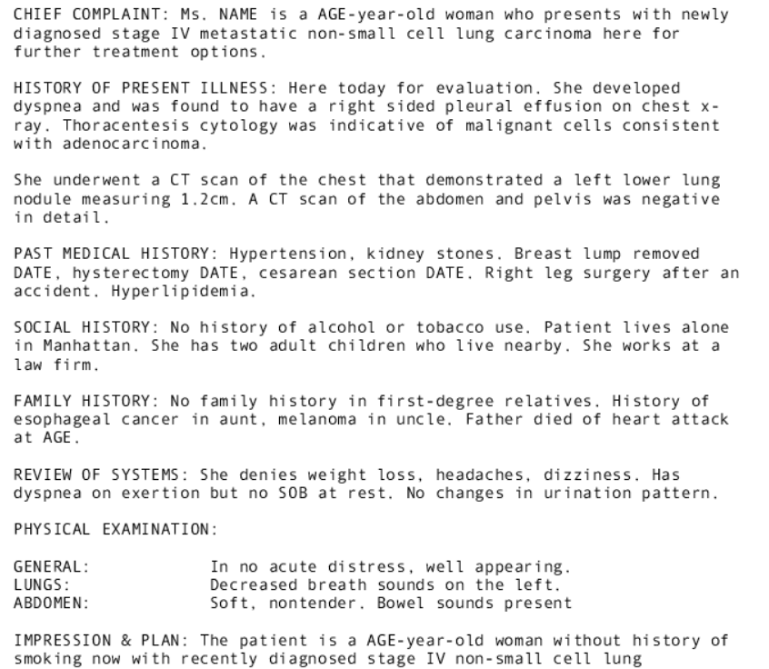
Codified vs. Narrative Data
All data in EHR is codified
All Data in EHR is narrative
Reality
Notes:
How does text fit into the overall clinical record?
Imagine 2 hypothetical worlds:
Left: Why is this implausible? (hell for clinicians!)
Right: why is this implausible? (Billing, risk stratification, epidemiology (disease tracking – upcoming lek), etc.

Slide 13
3/11/98 IPN SOB & DOE ↓ VSS, AF CXR ⊕ LLL ASD no Δ WBC 11K S/B Cx ⊕ GPC c/w PC, no GNR D/C Cef →PCN IV
Courtesy Peter Szolovits / MIT 6.7930
Notes:
What makes clinical notes so nasty to work with?
Another language. Clinicians talking to clinicians.
This: actual nursing note.

Slide 14
3/11/98 IPN
SOB & DOE ↓
VSS, AF
CXR ⊕ LLL ASD no Δ
WBC 11K
S/B Cx ⊕ GPC c/w PC, no GNR
D/C Cef →PCN IV
(Date) intern progress note
the patient's shortness of breath and dyspnea on exertion are decreased,
the patient's vital signs are stable and the patient is afebrile,
chest xray shows a left lower lobe air space density that is unchanged from the previous radiograph,,
a recent new white blood cell count is 11,000 cells per cubic milliliter,
,
the patient's sputum and blood cultures are positive for gram positive cocci consistent with pneumococcus, no gram negative rods have grown,
so the plan is to discontinue the cefazolin and then begin penicillin treatment intravenously
Notes:
AF could be atrial fibrillation but likely not in this context (next to VSS)

Slide 15
3/11/98 IPN
SOB & DOE ↓
VSS, AF
CXR ⊕ LLL ASD no Δ
WBC 11K
S/B Cx ⊕ GPC c/w PC, no GNR
D/C Cef →PCN IV
(Date) intern progress note
the patient's shortness of breath and dyspnea on exertion are decreased,
the patient's vital signs are stable and the patient is afebrile,
a recent new chest xray shows a left lower lobe air space density that is unchanged from the previous radiograph,,
a recent new white blood cell count is 11,000 cells per cubic milliliter,
,
the patient's sputum and blood cultures are positive for gram positive cocci consistent with pneumococcus, no gram negative rods have grown,
so the plan is to discontinue the cefazolin and then begin penicillin treatment intravenously

Slide 16
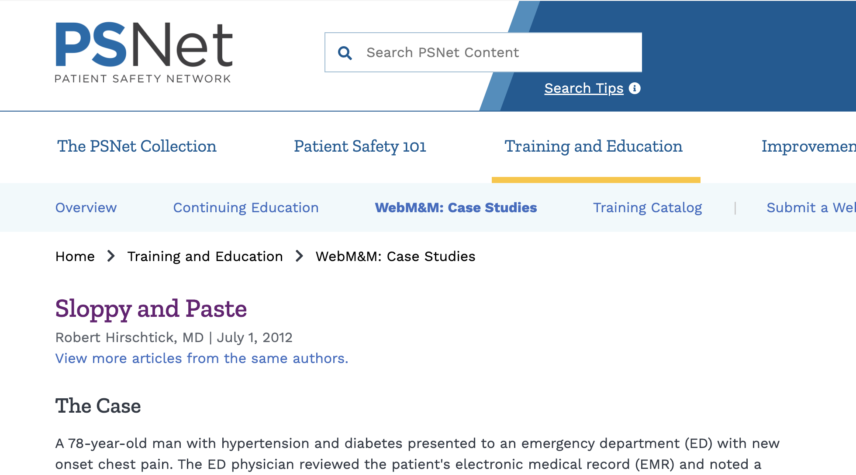
https://psnet.ahrq.gov/web-mm/sloppy-and-paste
Notes:
Copy & paste.
Providers often copy the last progress note and then edit selectively
Providers copy sections (e.g. meds) which haven’t changed
Problem because:
Chart bloat – “needle in a haystack” problem
Bias: Certain data can be overrepresented in training data
Case study reported here:
- patient with “PE” in note, kept getting carried forward. Presents in ED. Pulmonary embolism? CT to rule out.
- Turns out it stood for ‘physical exam’

Slide 17
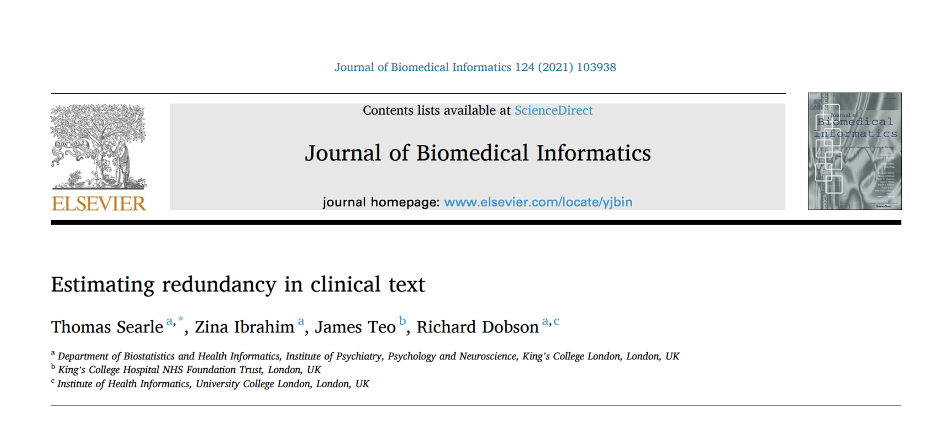

https://arxiv.org/pdf/2105.11832
Notes:
information theory angle: to estimate the amount of entropy or similarity between new and older notes.
Take 2 ”adjacent” notes from one person’s chart
Q: How would you measure the similarity between two clinical notes?

Slide 18
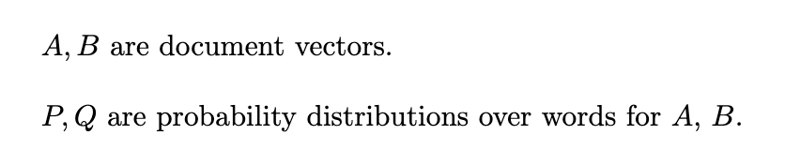
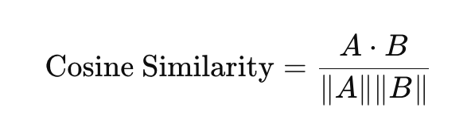
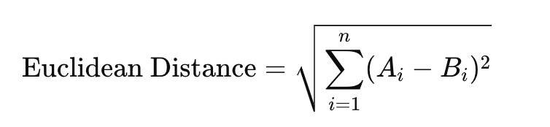
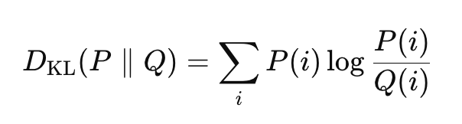
Measuring Document Similarity
1
2
3
(and TFIDF-weighted version)
KL-Divergence =
Notes:
A, B = word vectors for document. (Loose notation)
Paper uses none of these, instead it uses…

Slide 19
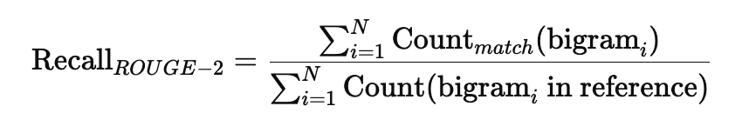
ROUGE score
Notes:
Can use unigrams, bigrams, trigrams. Etc.
Count_match = # of matching bigrams in reference & candidate

Slide 20
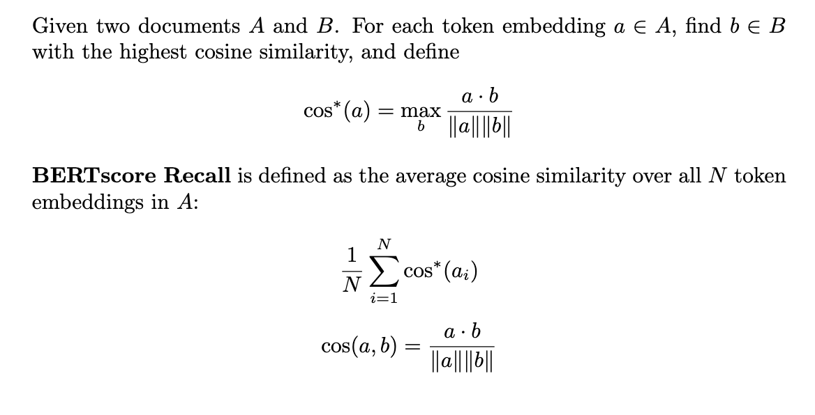
BERT score
Notes:
BERTscore
A softer match than ROUGE

Slide 21
BERT score
Notes:
Intuitively: recall: 1 if you can find an exact match for each token in the other doc. It’s 0 if you can’t find any match for any token. But you get "partial credit"
Similarly for precision (other way around)

Slide 22
BERT score
Notes:
Which (ROUGE or BERTscore) would be better at capturing when a provider copy/paste?
Which (ROUGE or BERTscore) would be better at measuring how conceptually repetitive the chart is?

Slide 23
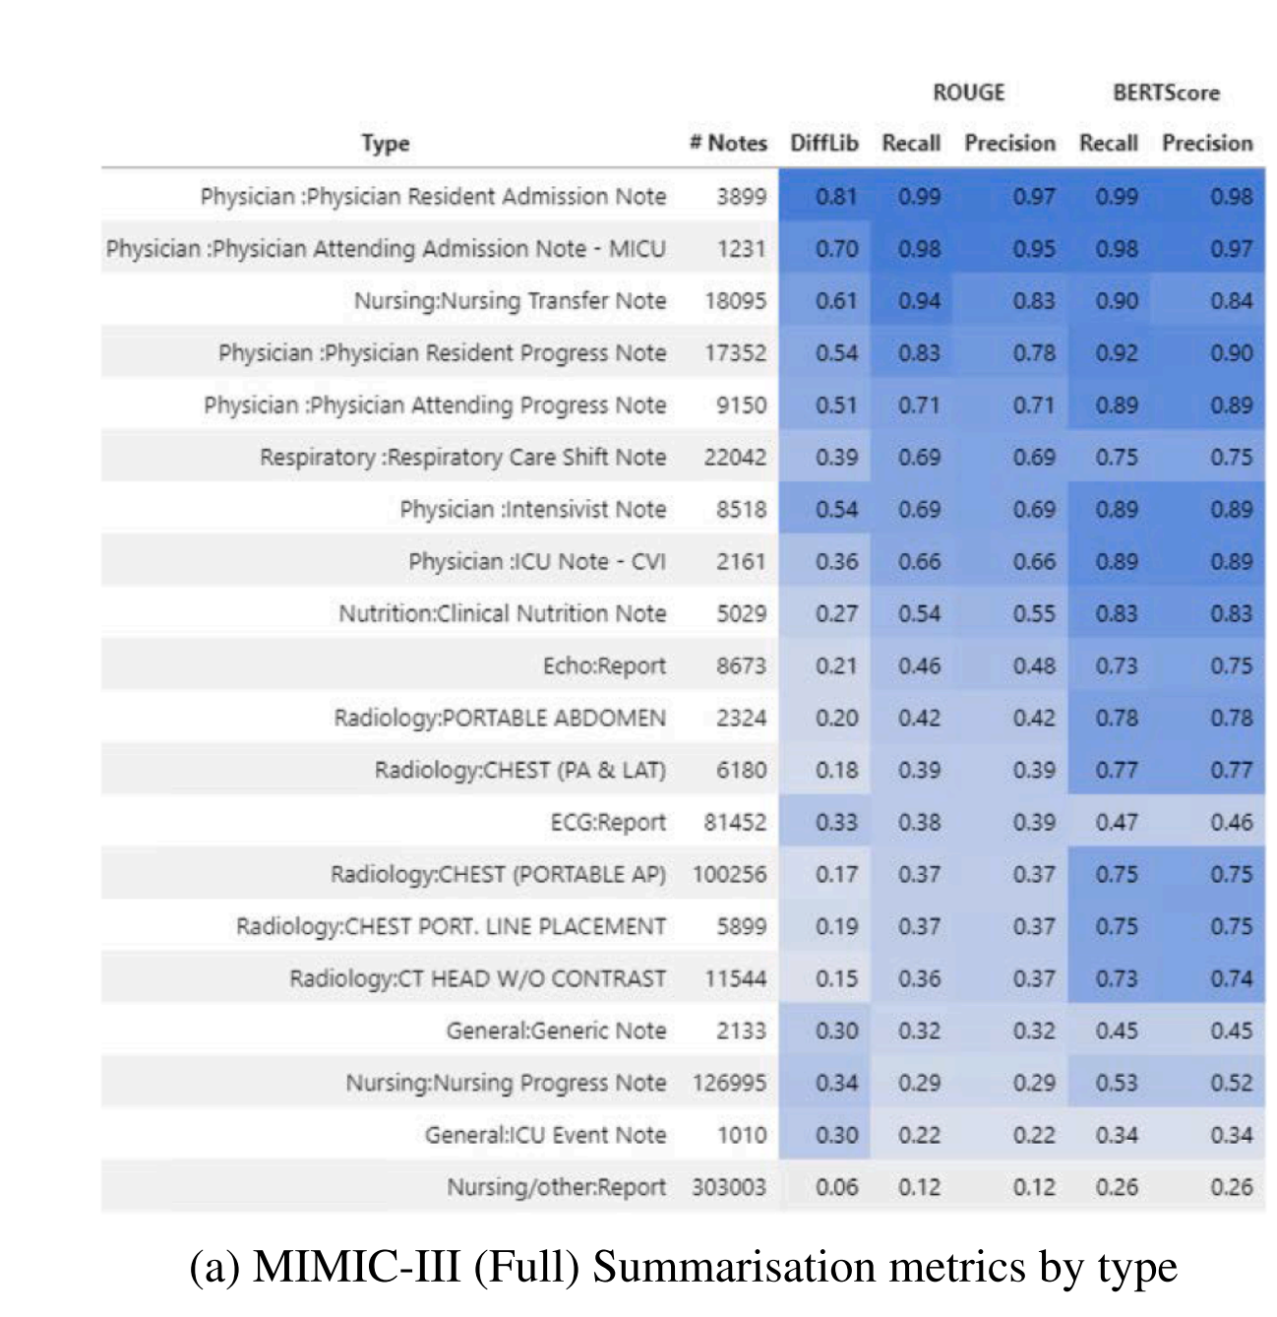
Higher perplexity
https://pubmed.ncbi.nlm.nih.gov/34695581/
Notes:
paper actually measured the BERT and ROUGE scores for various kinds of notes
Q: Why are nursing notes and general ICU notes so much lower redundancy?
Perplexity = 2^ (avg negative log likelihood) = 2^{ 1(1/N) \sum_i log p(x_))

Slide 24
Outline
Clinical Notes
Modeling text
Clinical NLP
Secondary use
ClinicalBERT
Notes:
Look at 2 ways to use text in a supervised learning setting
Bag of words
LDA

Slide 25
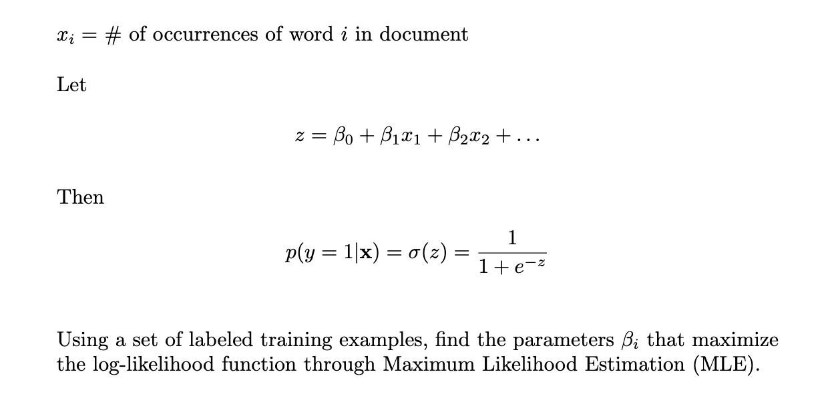
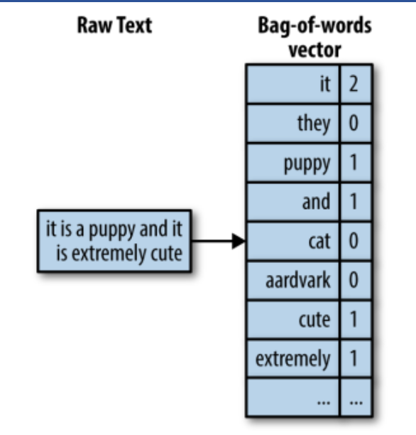
Bag of Words
https://mayurji.github.io/blog/2021/09/20/Tf-Idf
Notes:
Finally a little ML…
First and simplest modeling approach: Bag of words features with a log-reg binary classifier

Slide 26
Bag of Words
https://mayurji.github.io/blog/2021/09/20/Tf-Idf
Notes:
First and simplest modeling approach: “BoW features with a logistic regression binary classifier “
Say we're trying to predict if this patient will become diabetic.
Q: This approach is really simplified. Why?
- stopwords
- stemming
- regularization
- TDIDF weighting

Slide 27
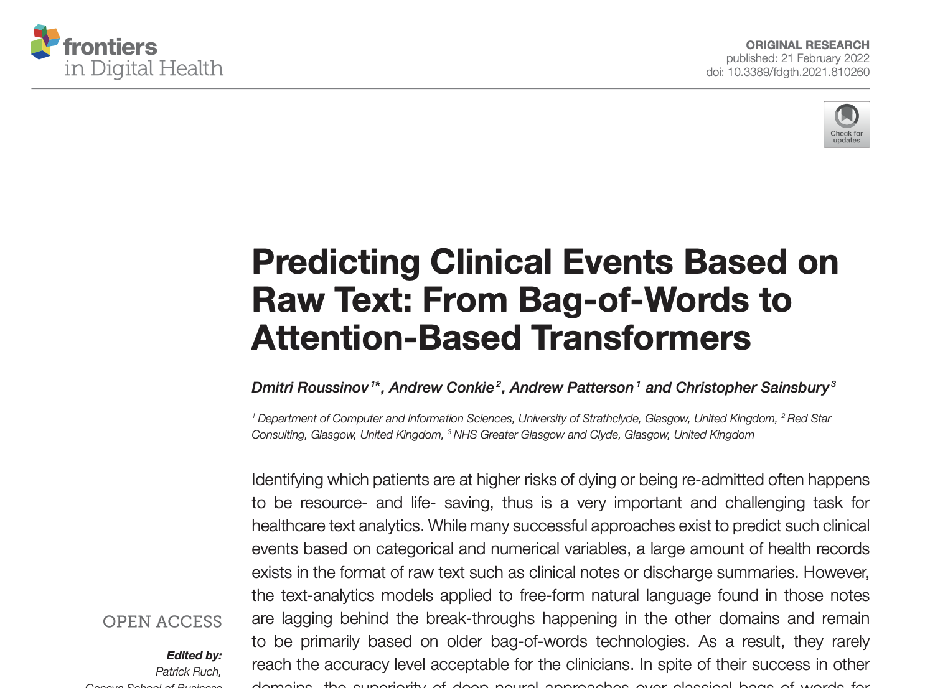
https://www.frontiersin.org/journals/digital-health/articles/10.3389/fdgth.2021.810260/full
Notes:
Bakeoff with a wide range of models
Use discharge summary notes from MIMIC data to predict 30d readmission

Slide 28
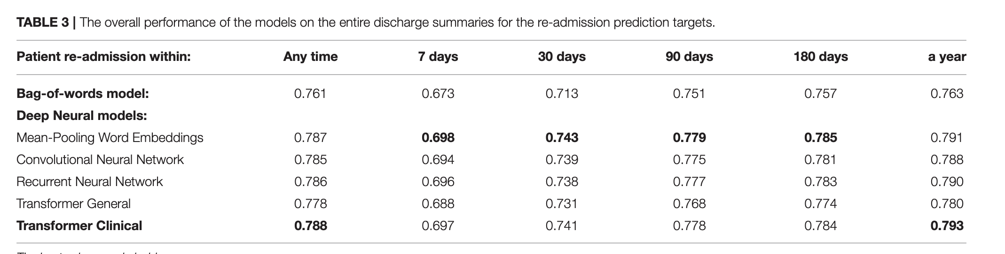
Bag of words model
https://www.frontiersin.org/journals/digital-health/articles/10.3389/fdgth.2021.810260/full
Notes:
BoW surprisingly well! Many examples of this in the literature.
Kind of an unfair example since the transformer in question had a context window of 500

Slide 29

Notes:
Why BoW perform so competitively vs. more sophisticated transformer-based models?
clinical notes are bags of words – key words like “sepsis” and “congestive heart failure”, not much nuance
Transformer models leverage nuanced interplay between words – less imp. in healthcare notes.
clinical notes have sparse but strong signals “hypertension” “diabetes”
Not so much training data for transformers in healthcare (mimic – 2m notes)

Slide 30
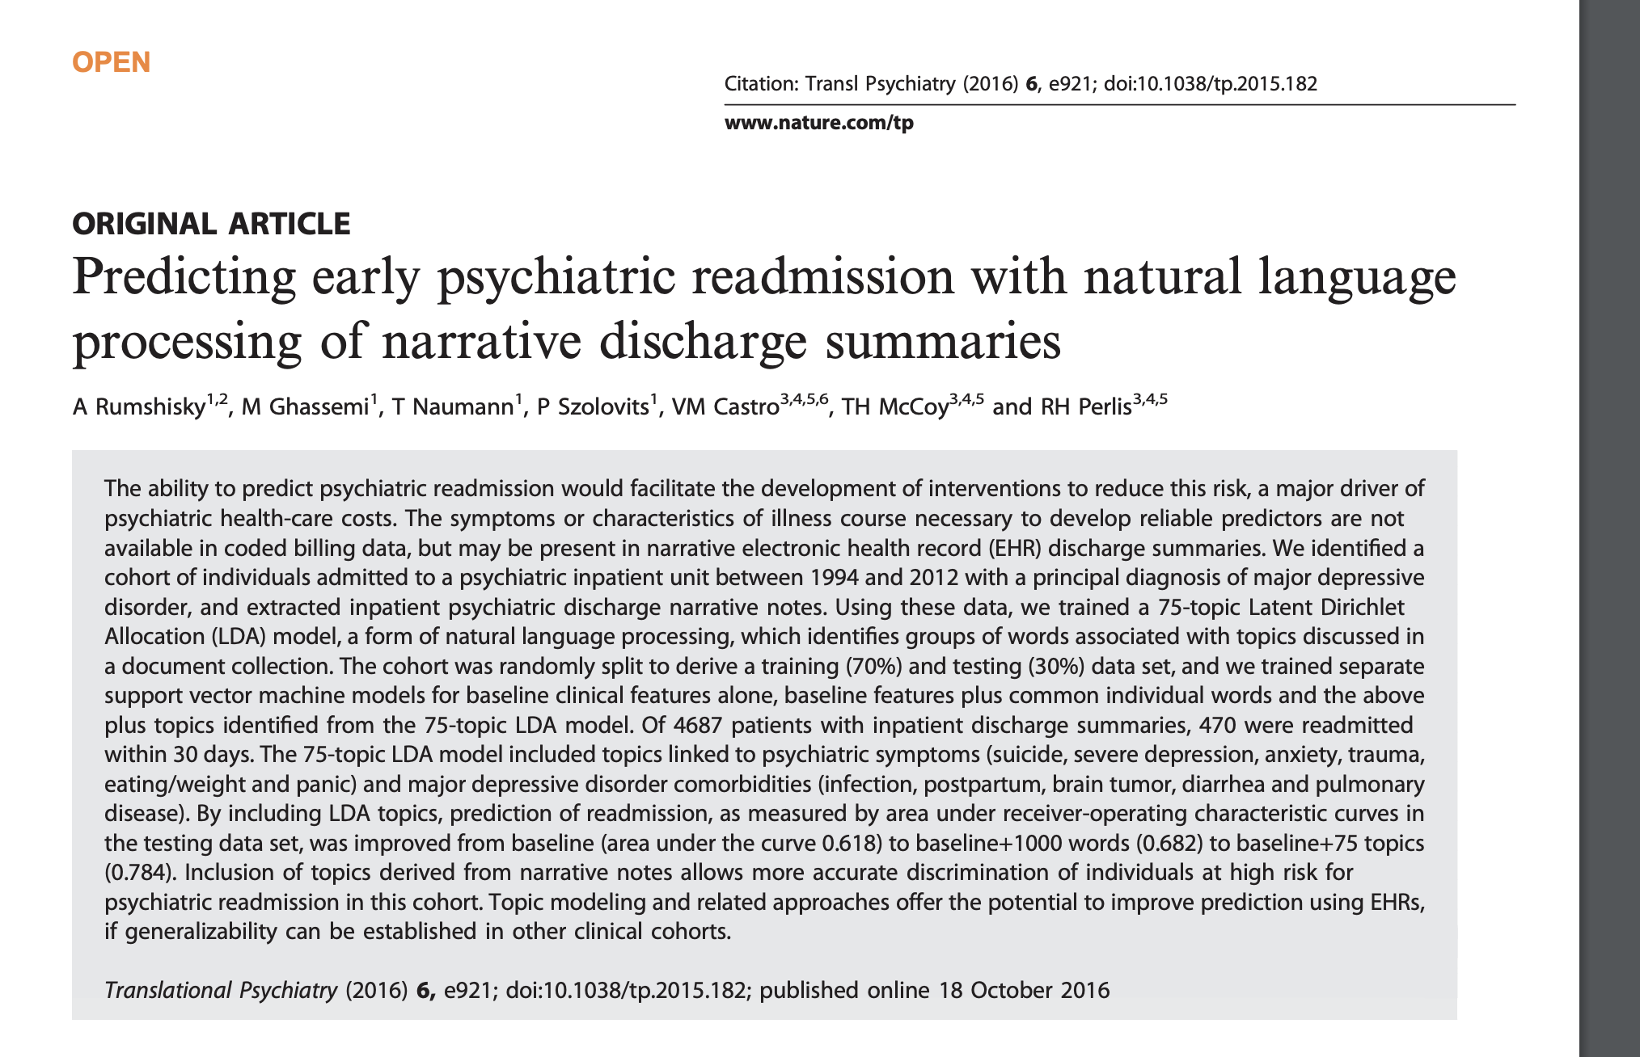
https://www.ncbi.nlm.nih.gov/pmc/articles/PMC5315537/pdf/tp2015182a.pdf
Notes:
an interesting and practical real-world use case
Article in Translational Psychiatry. ML researchers can publish anywhere!
Used discharge notes to predict readmission (one of our favorite applications)
~10% of cohort got readmitted in 30d

Slide 31
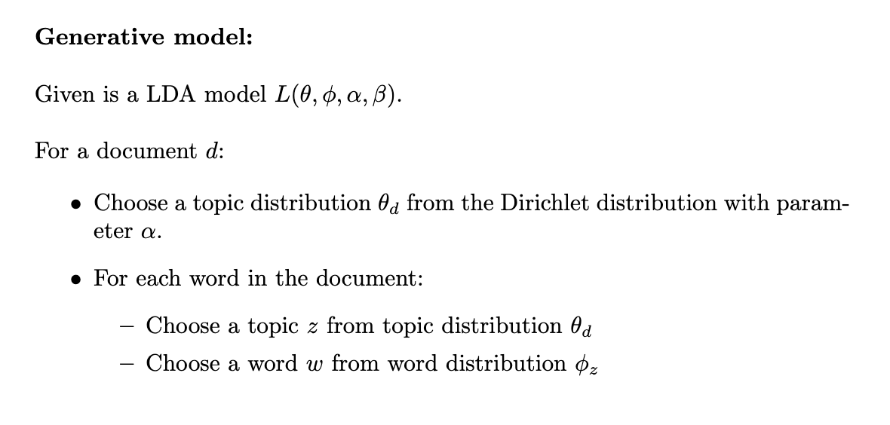
Latent Dirichlet Allocation (LDA)
Notes:
quick refresher on LDA modeling
generative model, and easiest way to understand is a hypothetical generative process
(Dirichlet distribution: a prob distribution over prob distributions)
note that LDA still uses the BoW simplification underneath – word order is ignored

Slide 32
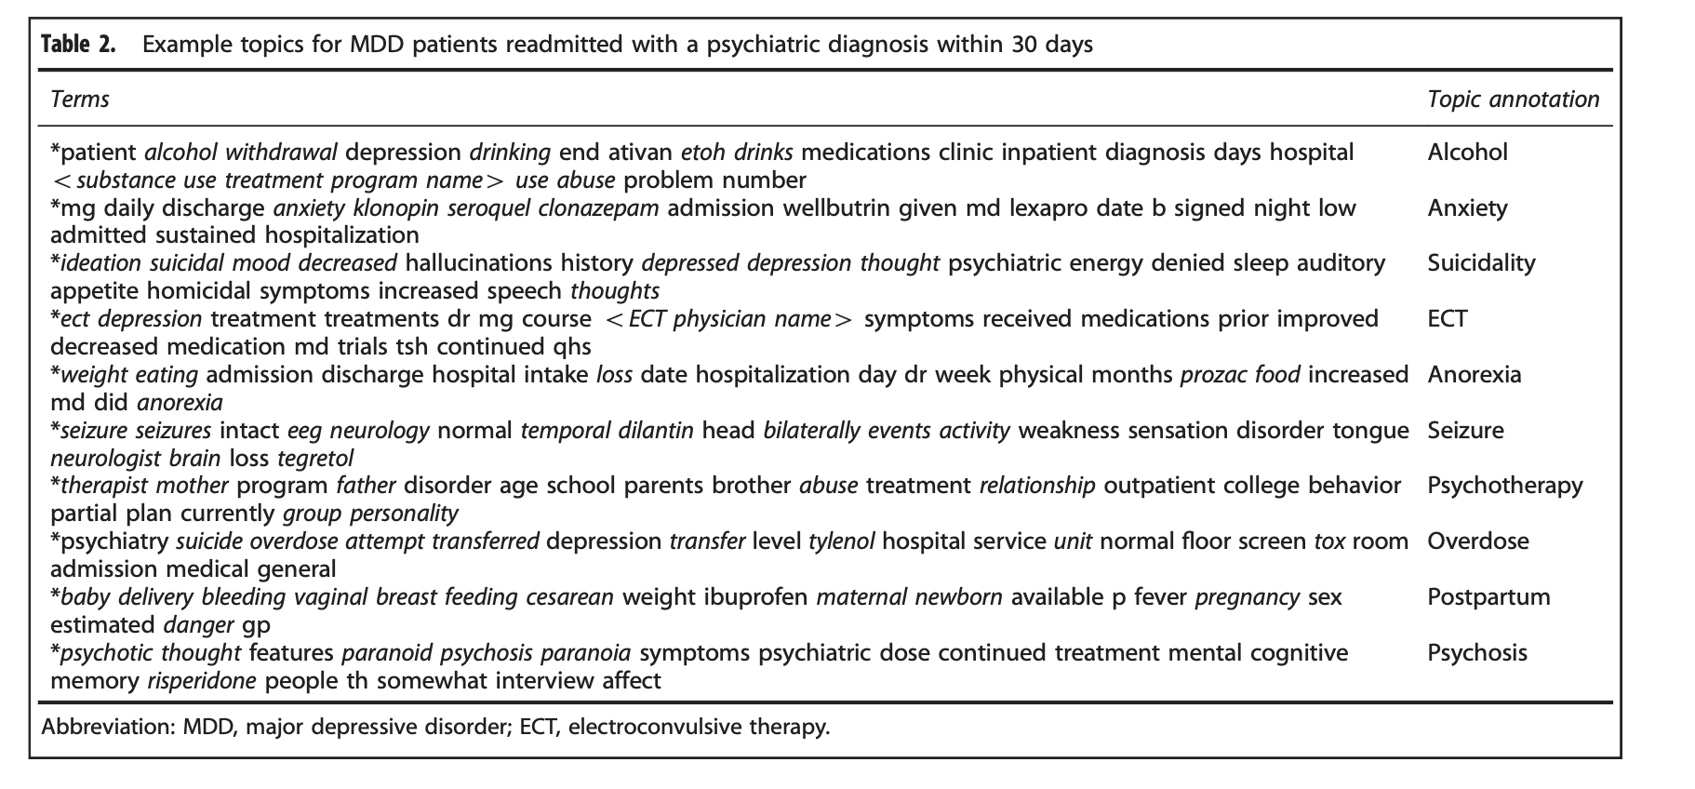
Notes:
Training:
- Use Gibbs sampling to estimate ML values for the models:
theta = p(topic | topic distribution)
phi: p(word|topic)
What you get is clusters or “topics” like this

Slide 33
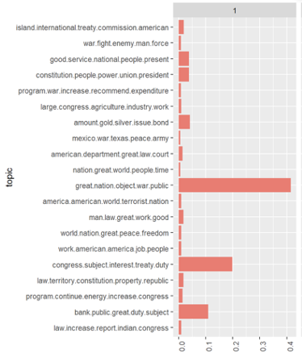
LDA: Inference
Topic labels
Topic weights
LDA model
Gibbs sampling
document
Notes:
Main goal of inference:
Given a document, can calculate k-dimensional vector of weights for each topic for that document
Q: Why might this be helpful?
- weights as features
***
Technically, LDA inference also gives you
Topic distribution theta_d for this document
Word distribution phi_z for this documnet
Topic assignments z for each word

Slide 34
0.1
0.2
0.1
0.04
0.3
0.1
0.07
0.03
0.1
Notes:
Right column: prob distribution over topics for this document

Slide 35
Evaluation
That, plus inferred LDA weights for discharge summary
Age, gender, insurance type, Charlson comorbidity index
Binary SVM classifier
Binary SVM classifier
Notes:
Q: how much of a predictive lift does the LDA weights give you?

Slide 36
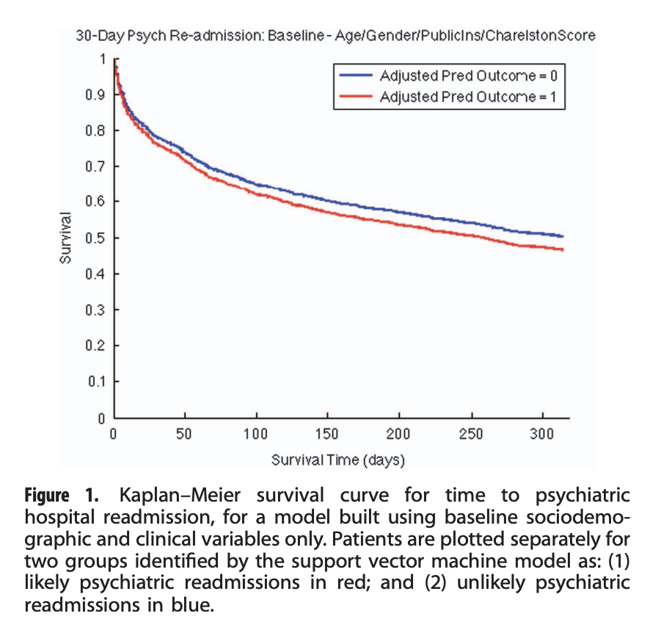
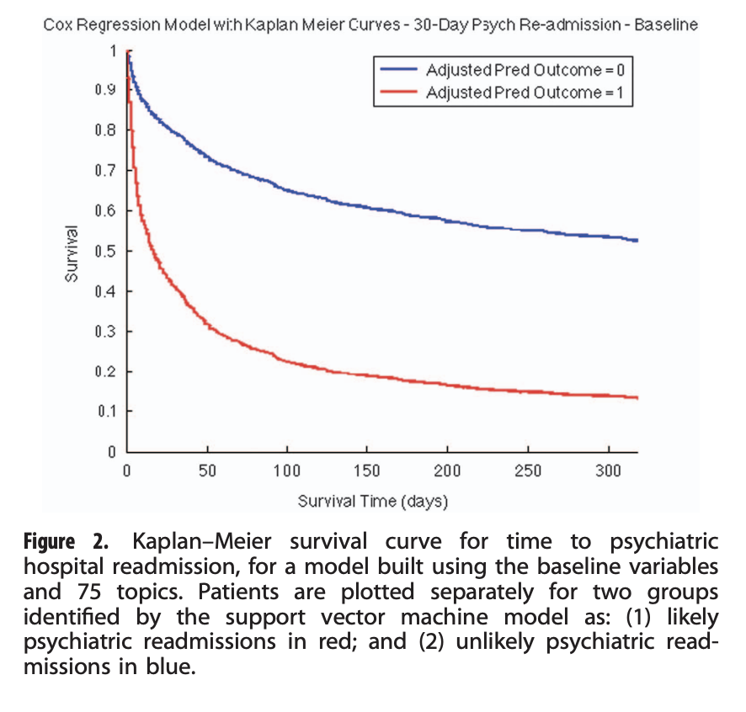
Notes:
Answer: a ton.
What’s the intuition for this?
data in the notes that’s not coded

Slide 37
Outline
Clinical Notes
Modeling text
Clinical NLP
Secondary use
ClinicalBERT

Slide 38


What does NLP do?
NLP
Extracted structure:
Named entities
Relations between entities
Mapping to codes
Modifiers: Negation, certainty, …
text document
Notes:
Completely different approach to modeling text
Explicitly surface latent syntactic structure
CTAKES, etc.

Slide 39
Application: AWS Comprehend Medical
Live demo
Notes:
Consider it a black box for now – just focus on the inputs and outputs
Q: Why might this output be useful?
Sample note:
75-year-old male with type 2 diabetes presents with acute confusion and disorientation. Blood glucose reading on arrival is 32 mg/dL. Patient is diaphoretic, tremulous, and unable to answer questions coherently. Rapid glucose administered, and patient admitted for management of hypoglycemia and evaluation of underlying cause.

Slide 40
Outline
Clinical Notes
Modeling text
Clinical NLP
Secondary use
ClinicalBERT
Notes:
“Secondary use”
What do you think this term means, when we’re talking about clinical notes?

Slide 41
Examples
Clinical decision support (lecture 12)
Clinical trial matching (lecture 17)
Ambient scribe (lecture 23)
Automated coding
Risk stratification
Patient chatbot
Automatic report generation
Social Determinants of Health (SDOH) Analysis
Literature review
Clinical Quality Measures (CQMs)
Cohort discovery
Notes:
Lots of examples
We'll look at just one.

Slide 42
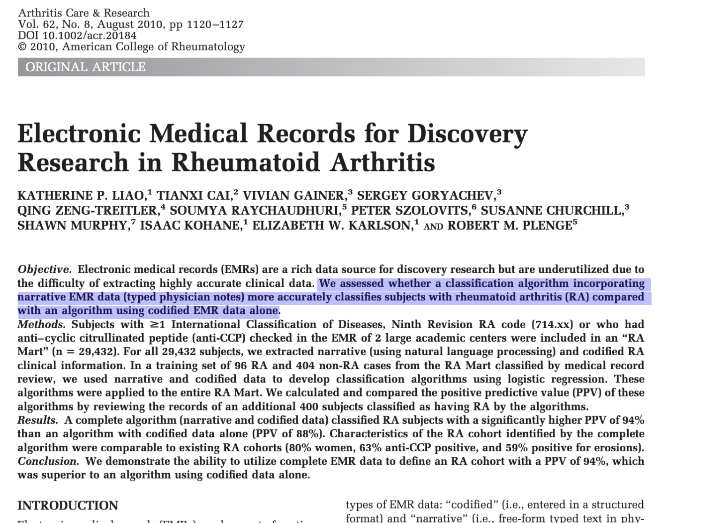
https://acrjournals.onlinelibrary.wiley.com/doi/epdf/10.1002/acr.20184
Notes:
Ancient paper but still relevant.
Doing a study on RA patients and needed to select a cohort from hospital records.
Needed a pure cohort of RA patients – going to spend a lot of $$ getting genetic sequencing done on each patient.
This is an example of a REGISTRY – important in clinical research! Can be $$ to build these.

Slide 43
Notes:
Q: What do you think is the PPV (=precision) for RA when a patient has an RA billing code in their chart? 90%? 25%?
It was 19%
Why so low? Billing codes are not for dx! (example of rule-out MI –> correct billing code is actually MI). Billing codes a very noisy representation of reality.
What about if we require 3 billing codes for RA? PPV still only 56%
So the authors wanted to build a model that predicted RA with high precision from the clinical notes

Slide 44
Candidate list of possible RA patients
Ran inference on each model against RA mart to find suspect RA cases
EMR
n = ~4M
RA Mart
n = 29,432
Filter: ≥1 ICD RA (714.xx) n=25,830 OR
anti-CCP
n=3,602
Predicted RA cases
n ~ 3,585
Build 3 classifiers
Expert-labeled training set (n=500)
MRR on 400 cases
96+, 404-
Report PPV
Notes:
This is all on retrospective EMR data - never saw a patient.
Medical record review on the 400
(The presence of anti-CCP antibodies is highly specific for RA)

Slide 45
Candidate list of possible RA patients
Ran inference on each model against RA mart to find suspect RA cases
EMR
n = ~4M
RA Mart
n = 29,432
Filter: ≥1 ICD RA (714.xx) n=25,830 OR
anti-CCP
n=3,602
Predicted RA cases
n ~ 3,585
Build 3 classifiers
Expert-labeled training set (n=500)
MRR on 400 cases
96+, 404-
Report PPV
Notes:
(Walk though this)
again - This is all on retrospective EMR data - never saw a patient. Example of a secondary use applciation.
(The presence of anti-CCP antibodies is highly specific for RA)
***
Starting with the complete EMR (narrative and codified data), we 1) created an RA database (RA Mart) of all possible RA patients; 2) randomly selected 500 subjects from the RA Mart for medical record review to develop a training set of RA and non-RA cases; 3) developed and trained 3 classification algorithms on the training set; 4) applied the 3 classification algorithms to the RA Mart to obtain the predicted RA cases; and 5) validated the classification algorithm by performing medical record reviews on 400 of the predicted RA cases (i.e., a validation set) to confirm RA status to determine the PPV. Steps 3–5 were conducted for each algorithm: narrative and codified EMR data (complete), codified EMR data, and narrative-only EMR data.

Slide 46
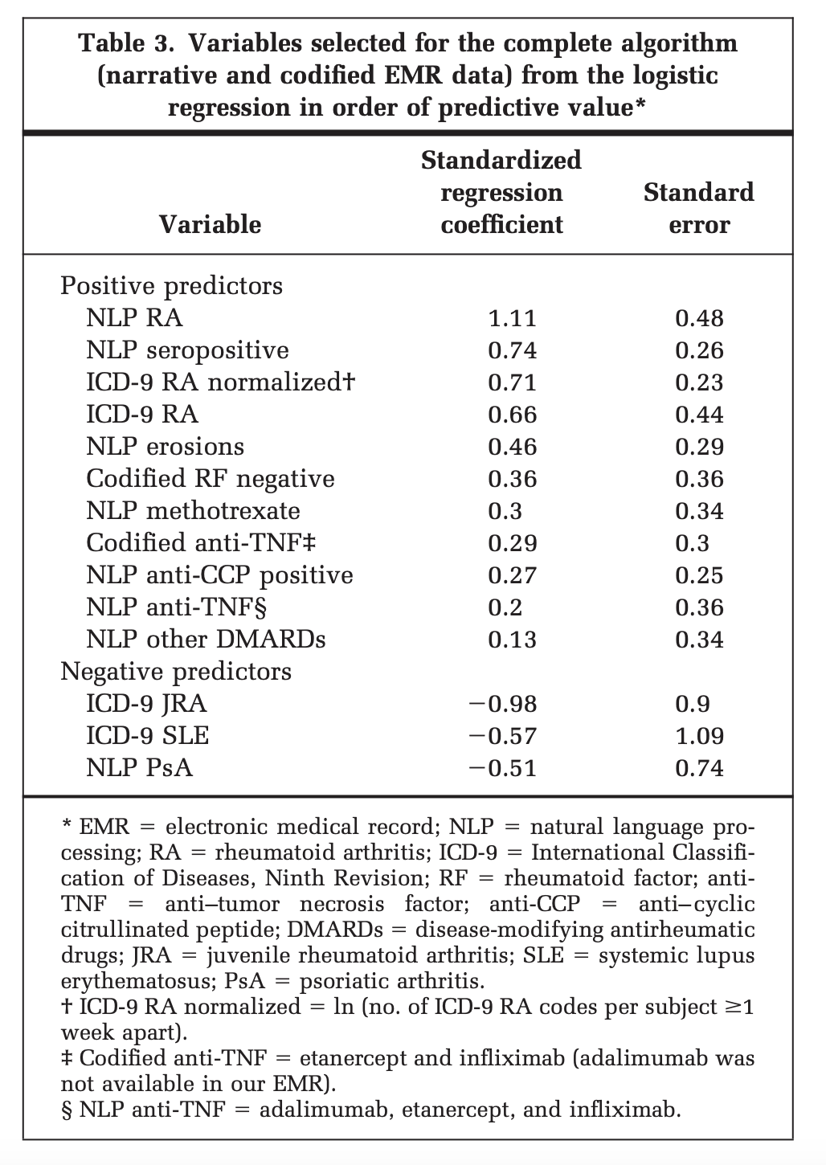
Notes:
table from the paper
We know what regression coefficient are, what about standardized regression coefficients?

Slide 47
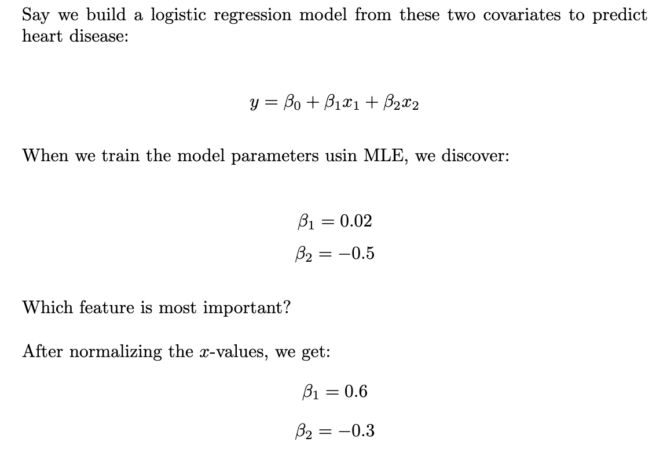
Standardized Regression Coefficients
Notes:
Say
x1 = hours per week of exercise
x2 = average blood pressure
completely different scales

Slide 48
Standardized Regression Coefficients
Notes:
(Walk through)
It's very simple idea
Normalize by taking each point in the data and subtracting the mean and dividing by the std dev

Slide 49
Standardized Regression Coefficients
Notes:
Normalize by taking each point in the data and subtracting the mean and dividing by the std dev

Slide 50
Notes:
Now we can look at this again and actually know what we’re looking at

Slide 51

Notes:
Acknowledge the power of linear models.
Simple models (e.g. BoW+LR, LDA) often perform at par with DL models in clinical applications.
Don't automatically jump to a DL model as a first instinct for many reasons. Explainability is one of them.

Slide 52
Outline
Clinical Notes
Modeling text
Clinical NLP
Secondary use
ClinicalBERT

Slide 53
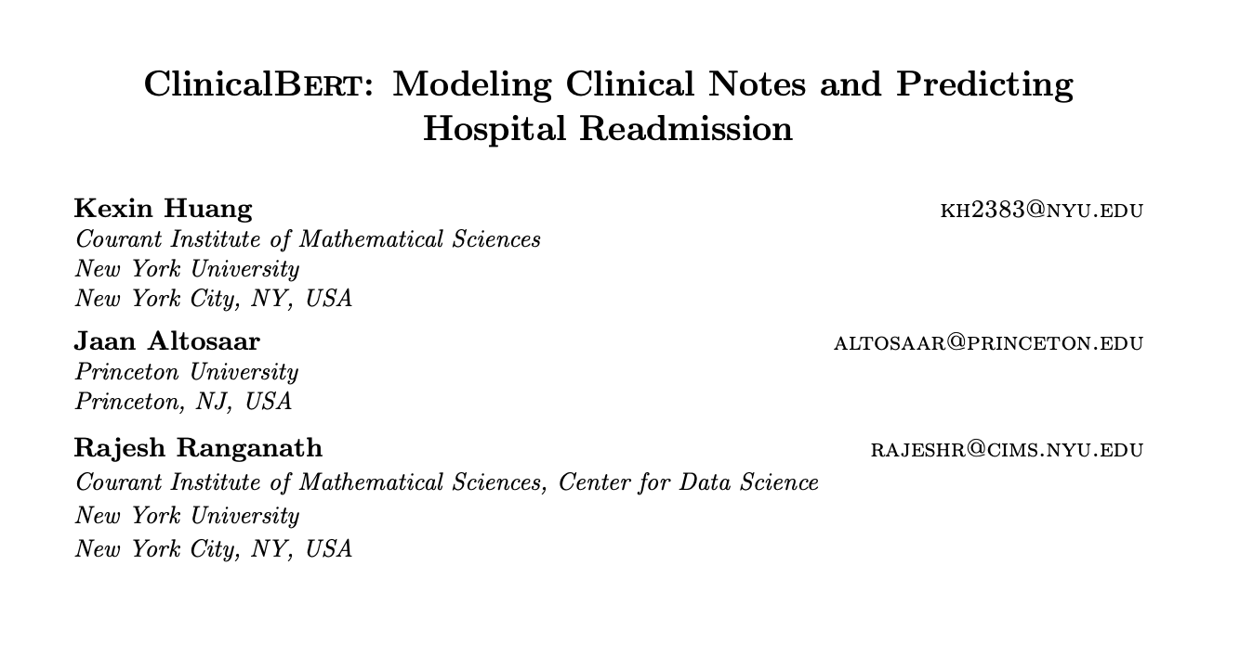
https://arxiv.org/pdf/1904.05342
Notes:
From 2019
BERT had just come out. This was one of a few papers that applied BERT to clinical notes.

Slide 54
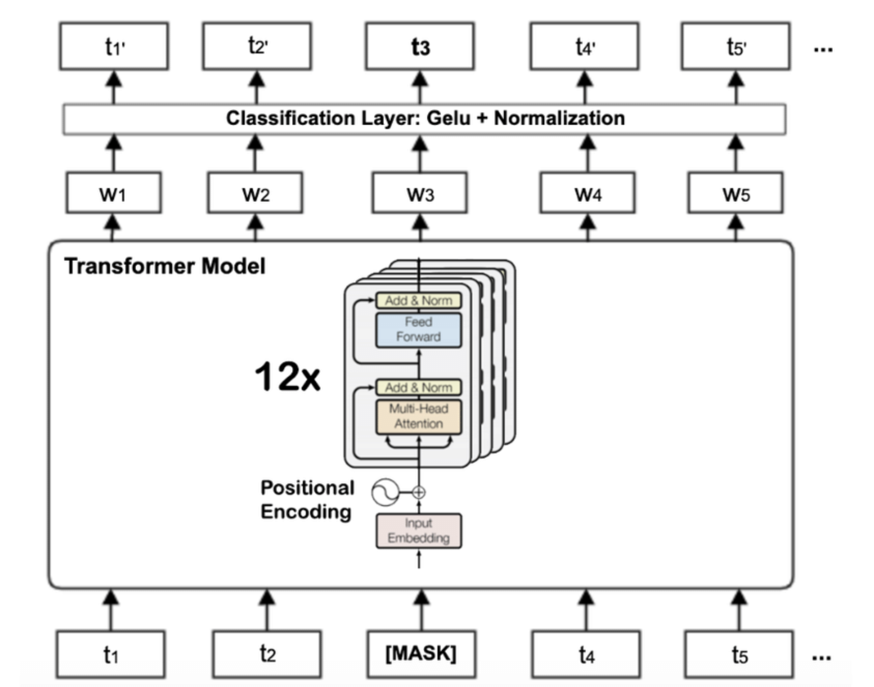
BERT Refresher
https://arxiv.org/abs/1810.04805
Notes:
Bidirectional Encoder Representations from Transformers
Discriminative, not generative model
Word embeddings – incredible advances in the last decade.
Word2vec: Neural network, used skip gram and CBOW objective
ELMO: context-sensitive. LSTM based
BERT: transformer based

Slide 55
BERT vs. ClinicalBERT
 | Original BERT | ClinicalBERT
Training data | 3.3B tokens from BooksCorpus and English Wikipedia | 2M clinical notes from MIMIC III
Task(s) | 11 common natural language tasks, e.g. question-answering and language understanding | 30d readmission
Notes:
Started with the trained BERT params, trained on MIMIC notes.
Should they have trained ClinicalBERT on general training data and then on mimic notes?

Slide 56
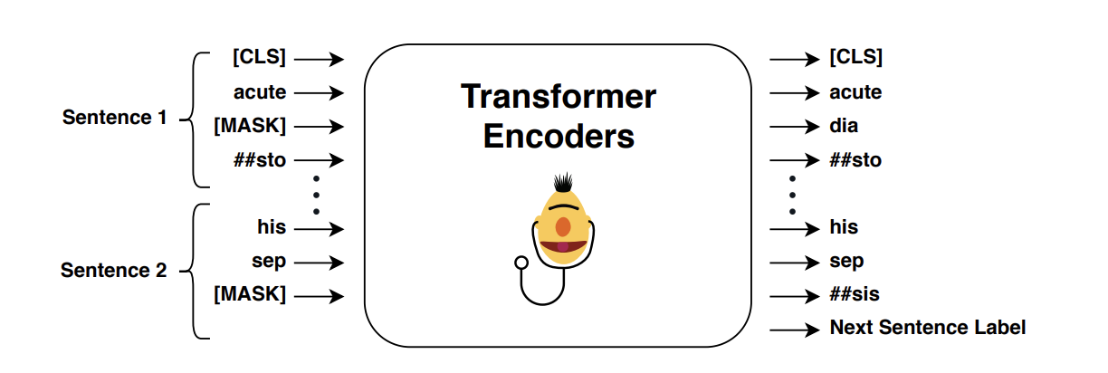
MLM Training Objective
Notes:
Same training objective as BERT:
Masked language modeling (MLM) and Next sentence prediction (NSP)
showing MLM here
15% of tokens masked and model forced to predict them.

Slide 57
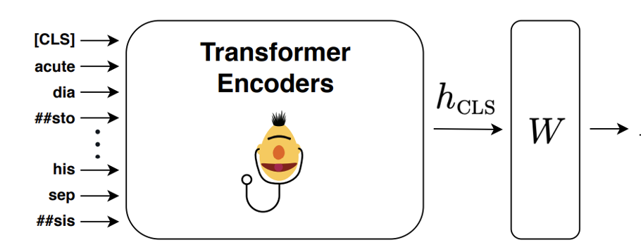
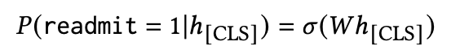
Classifier Head
Notes:
BERT not really useful by itself, but as a building block
Paper uses 30d readmit (of course!)
Train W matrix
Sigmoid = 1 / 1+ e^-{Wh)
The paper github repo actually contains a tutorial on how to build your own head.

Slide 58
30d Readmit Prediction
Select a random subset (‘cohort’) of all MIMIC patients
34,560 patients
2,963 positive readmission labels
42,358 negative labels

Slide 59
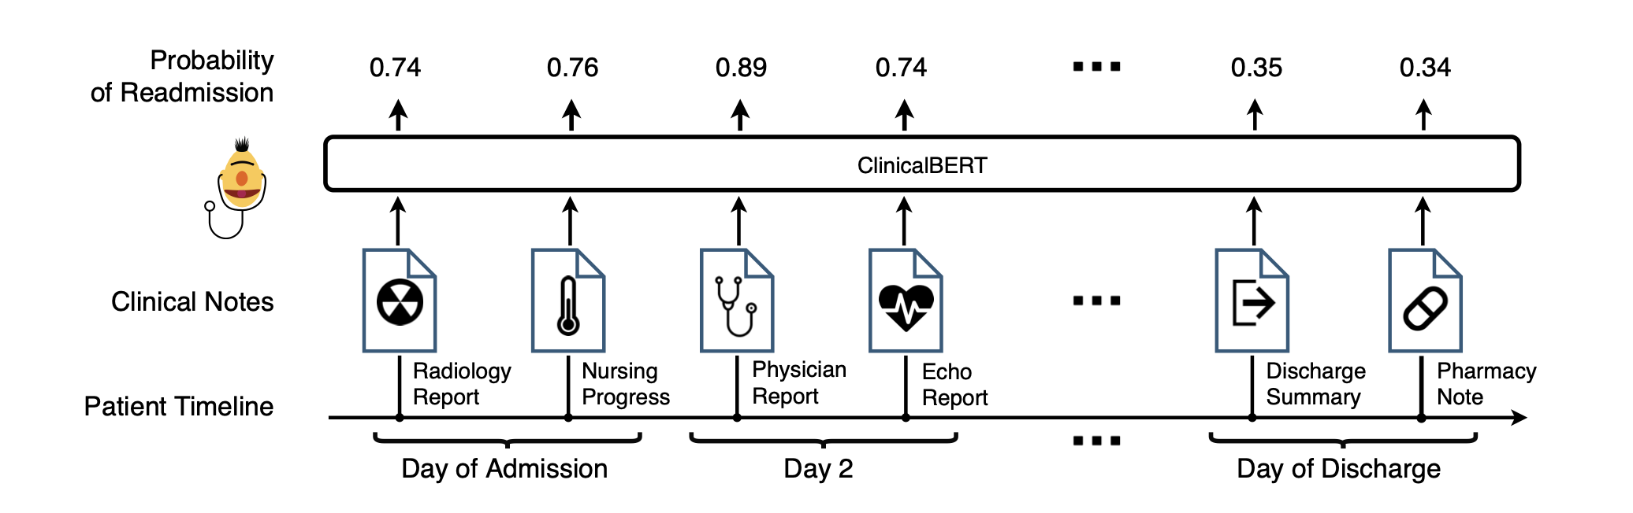
Readmit likelihood changes as new notes appear

Slide 60
Problem: Context Window < Note Length
Notes:
BERT has fixed context length (512)
Concatenated notes may exceed this
How might you solve this?
(Noew

Slide 61
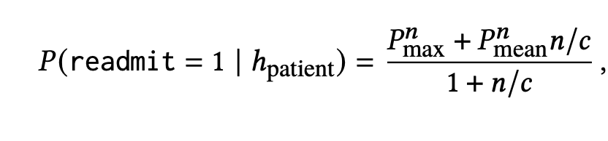
Scalable Readmission Prediction
all notes for patient, concatened
p(y|x)=0.3 p(y|x)=0.8 p(y|x)=0.1. …
n = 512 model context length
n = # documents for this patient
c = weighting parameter
Notes:
Split them up
Each gets a prob
How would you combine these probabilitius?
Average them? (Max is important!)
Take the max? (may be spurious)
Heuristic.
Q: for a fixed n, what happens as c gets large? Small?
large c: rely on the max more
small c: rely on the mean more
n incresases -> mean matters more
(they used c=2)

Slide 62
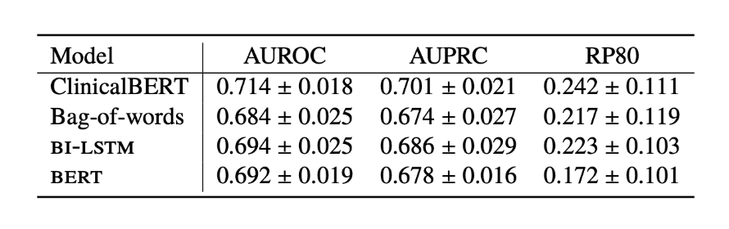
30D Readmission: Results
Using just discharge summary
Notes:
RP80 = recall at precision 80%. Why? False positives are $$, want to limit those. Set at 20% FPs and see how well you can do on recall.
(NOTE: The paper also shows results from first 24h/48h after admission)
Why does it outperform BERT? (esp on RP80)

Slide 63
Questions
What other tasks could you apply ClinicalBERT to?
Any shortcomings of the ClinicalBERT paper?
Notes:
Disease prediction, biling codes, qualify for clinical trial , …
My $0.02: trained on MIMIC data, which is only critical care – only 1/6 of all hospital admits are to ICU

Slide 64
EOL

